Slide 1
Vocab Work in English
Wie lernt man am schnellsten Englisch?

Slide 2
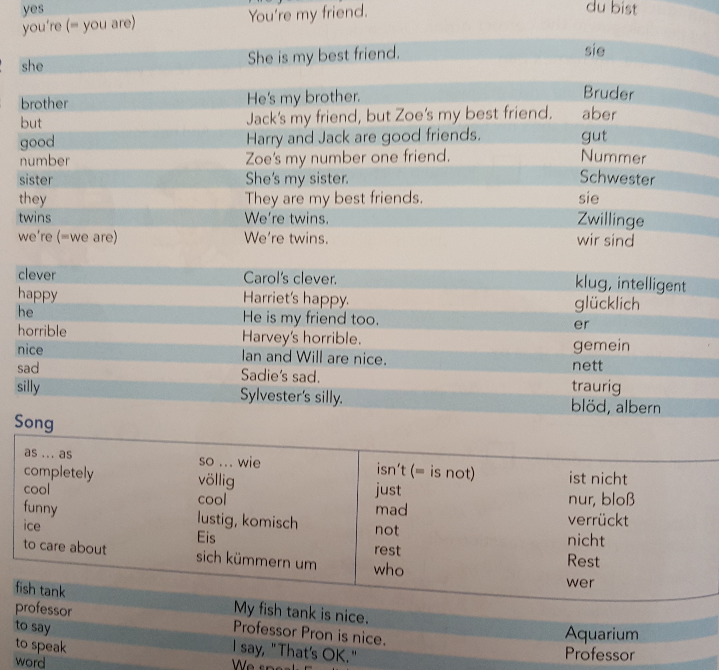
Vokabellisten
Nein
DANKE !!!

Slide 3
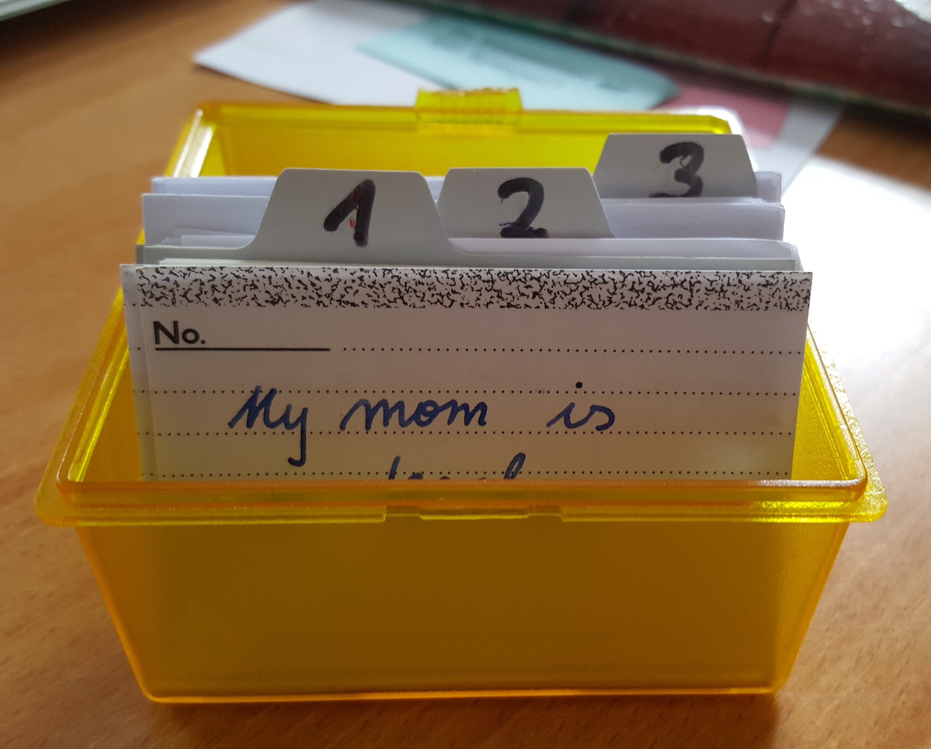
Arbeit mit der Vocab Box
Vocab practice book
neue Karten
This Photo by Unknown Author is licensed under CC BY

Slide 4
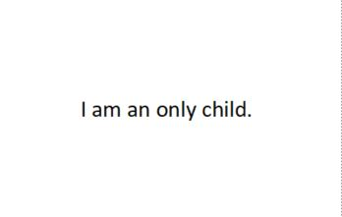
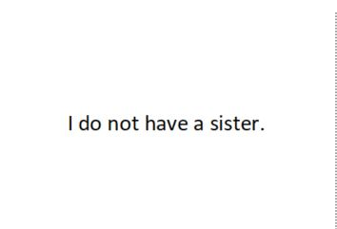
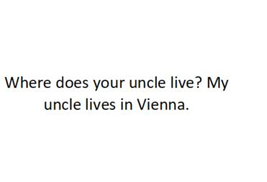
1. Walk and Talk
I am an only child.
I am an only child.
I am an only child
Sprechen
Gehen

Slide 5
Walk and Talk
My mother is called Renate..
My mother is called Renate.
My mother is called Renate.
Sprechen
Gehen

Slide 6
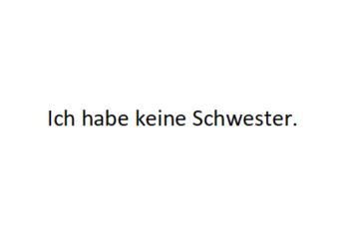
2. Write and Check
I do not have a sister
This Photo by Unknown Author is licensed under CC BY-SA
This Photo by Unknown Author is licensed under CC BY-NC-SA

Slide 7
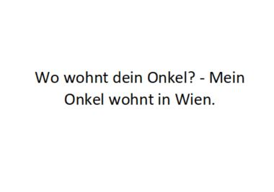
Write and check
Where does your onkl live?
uncle
This Photo by Unknown Author is licensed under CC BY-NC-SA

Slide 8
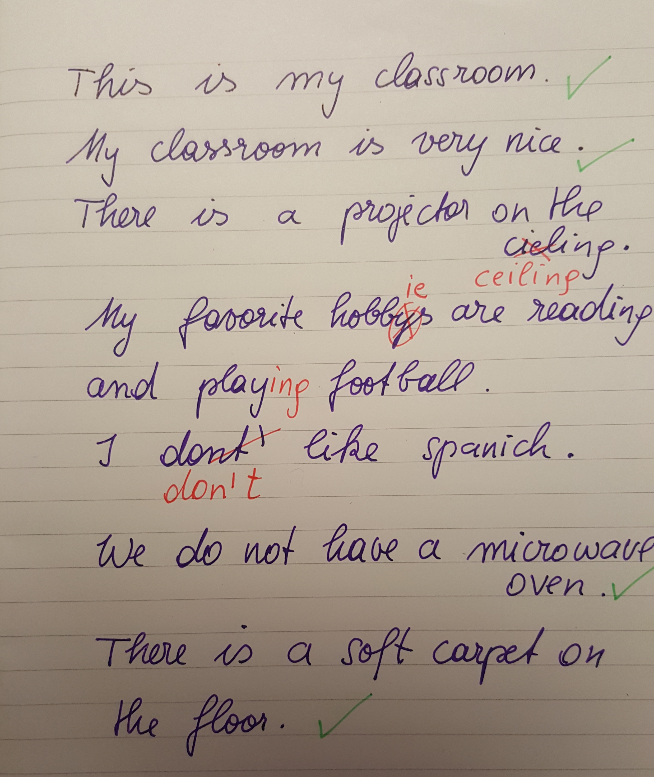
Faustregel
10 Kärtchen pro Tag
oder
10 Minuten pro Tag

Slide 9
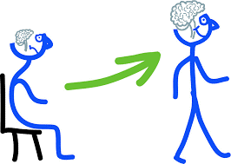
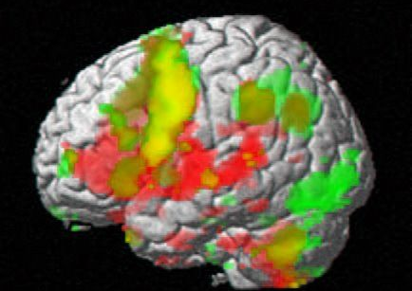
Warum ist das so Wichtig?

Slide 10
Stretch your memory

Slide 11
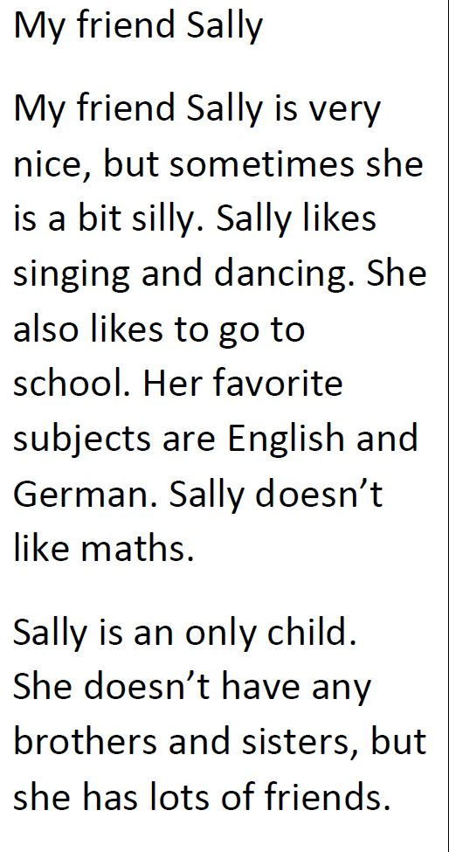
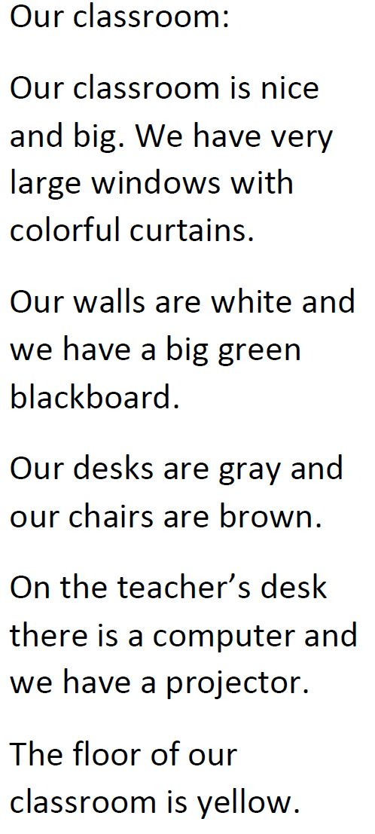
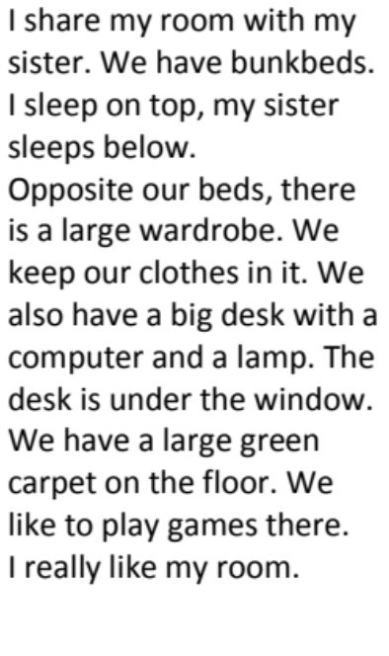
Stretch your memory

Slide 12
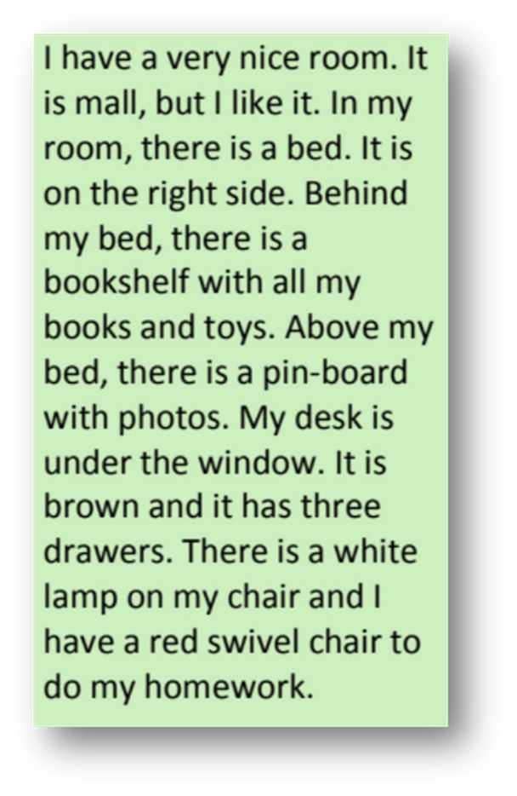
Überprüfen CHECK !!!
It is small, but I like it.
Ich merke mir einen Satz…
I have a very nice room.
In my room there is a bed.
Gehe …..möglichst weit… zu meinem Tisch…..
Ich gehe zurück und merke mir den nächsten Satz.
… und schreibe den Satz in mein Heft.
I have a very nice room.
It is small, but I like it.
there is
In my room, is a bed.

Slide 13
Warum ist das so Wichtig?

