Slide 1
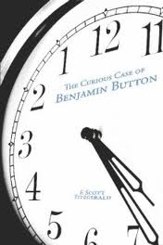
Benjamin Button
If only one thing had happened differently…

Slide 2
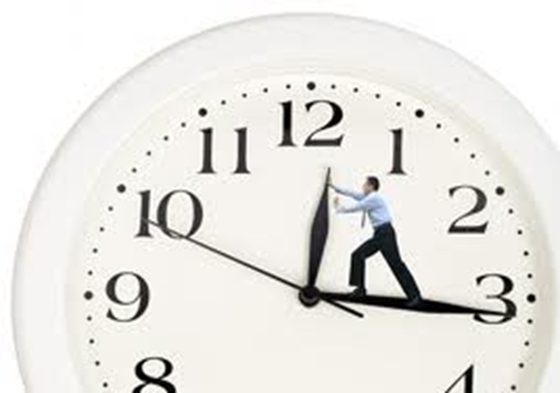
Watch the Scene
and take notes

Slide 3
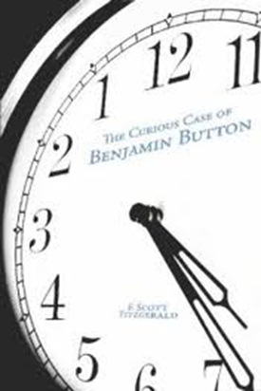
If only….
if only the shoelace
hadn’t broken…
or (if) the delivery truck
had moved moments earlier
or (if) the package
had been wrapped and ready...
…because the girls
hadn’t broken up with her boyfriend…

Slide 4
…or if the man
had set his alarm and got up five minutes earlier
…or (if) the taxi driver
hadn’t stopped for a cup of coffee…
…or (if) the woman
had remembered her coat…
…and had gotten into an earlier cab…

Slide 5
Daisy and her friend
would have crossed the street…
and the taxi
would have driven by them…
But life being what it is… a series of intersecting lines and incidents…
Out of anyone’s control .
The taxi did not go by…and the driver was momentarily distracted.
And he didn’t see Daisy crossing the street.
and that taxi hit Daisy … and her leg was crushed.

Slide 6
Now do your own… What would your life be like if you hadn’t been accepted at GIBS?
If I hadn’t been accepted at GIBS…

