Slide 1

Writing Feedback given by AI tools

Slide 2

Bad Neighbours: original text written by ESL student, age 15
Have you ever had that situation when your neighbours are loud, and noise and you don’t know what to do? Thats what is my problem at the time. We just moved to a new house. It’s really big with a nice backyard and a second floor with a balcony. My brother and I have our own rooms now and it’s just phenomenal. My room is on the second floor, and I have my own en suite bathroom. What’s more we have a garage for our car.
So, our neighbours are very noisy, for example they often have parties in the evening and at night. Another thing is that they often hear music very loudly and much more stuff like just not beeing kind.
I personally think it’s not nice of them to be so thoughtless about their neighbours and just completely forget that they are not the only one living in the neighborhood. Someone really has to go to them and tell them that are loud and noise so they stop. Otherwise I think I should call the police.
Or what’s your opinion about that? Maybe one of you can help me.
WRITIFY.AI: Here is the paragraph rewritten in a neutral tone of voice:
"New Neighbors Some individuals may find themselves in a situation where their neighbors are noisy, and they are unsure of how to address the issue. This appears to be the case for the writer. They have recently moved to a new, larger house with a nice backyard, a second floor with a balcony, and individual rooms for the writer and their brother. The writer's room is on the second floor and has an en-suite bathroom. Additionally, the house has a garage for their car. While the new living situation seems quite favorable, the writer is facing a challenge with their neighbors' noise levels.“
The neighbors are quite noisy. They frequently have parties in the evenings and at night. Additionally, they often play music at a high volume. There are other inconsiderate behaviors as well.
It seems the neighbors are not mindful of the impact their actions have on the surrounding community. Someone may need to have a conversation with them to make them aware of the disturbances they are causing. Alternatively, contacting the authorities could be an option if the issues persist.
What are your thoughts on the best approach to address this situation? Perhaps you have a suggestion that could help resolve the matter.

Slide 3
Friendly Neighbors (Writify.AI, Friendly tone)
Hey there! Have you ever found yourself in a situation where your neighbors are just a little too loud, and the noise is really getting to you? Well, that's the predicament I'm in right now. You see, we just moved into a brand new house, and it's absolutely fantastic. It's a really spacious place with a lovely backyard and a second floor with a balcony. My brother and I each have our own rooms now, which is just incredible. My room is on the second floor, and I even have my own private bathroom. And the best part? We have a garage for our car. It's just been such a wonderful experience settling into this new home, you know? The only downside is that the neighbors can be a bit noisy at times, but I'm sure we'll figure out a way to work through that. Overall, I'm just so grateful for this new chapter in our lives."
"I'm sorry to hear that your neighbors are being so noisy and inconsiderate. It must be really frustrating to deal with that. I can understand why you're feeling annoyed with them.
It sounds like they often have loud parties and play music at high volumes, which can be really disruptive, especially at night. That's not very considerate of them towards the rest of the neighborhood.
If I were in your shoes, I would try talking to them first, in a friendly and polite way, to see if they'd be willing to be more mindful of the noise level. Maybe they're not even aware of how much it's impacting you and the others around them. It's worth a try to see if you can resolve it amicably.
However, if they continue to be uncooperative and the noise persists, then I think calling the police would be a reasonable next step. You shouldn't have to put up with that kind of disturbance, especially in your own home.
I hope you're able to find a solution that works for you. Let me know if you need any other suggestions or advice. I'm happy to lend an ear and provide any support I can."
Problematic Neighbors (Writify.AI, Formal)
It is not uncommon to encounter situations where one's neighbors exhibit disruptive behavior, such as excessive noise, which can be quite challenging to address. This is precisely the predicament I find myself in at the present moment. My family and I have recently relocated to a new, spacious residence, complete with a sizable backyard and a second floor featuring a balcony. My brother and I now have our own private quarters, which is a remarkable improvement. My personal living space is situated on the second level and includes a private en-suite bathroom. Furthermore, we have the added convenience of a garage to accommodate our vehicle.
The residents adjacent to my dwelling place exhibit a significant degree of noise disturbance. For instance, they frequently hold social gatherings in the evening and late-night hours. Additionally, they often play music at an excessively high volume. Furthermore, they display a general lack of consideration for their neighbors.
Personally, I believe their inconsiderate behavior is unacceptable. They appear to disregard the fact that they are not the sole occupants of the local community. I believe it would be prudent for someone to approach them directly and inform them that their actions are disruptive. Failing a resolution through this approach, I may be compelled to contact the relevant authorities.
I welcome any opinions or suggestions you may have regarding this matter. Perhaps one of you could provide guidance on the most appropriate course of action.

Slide 4

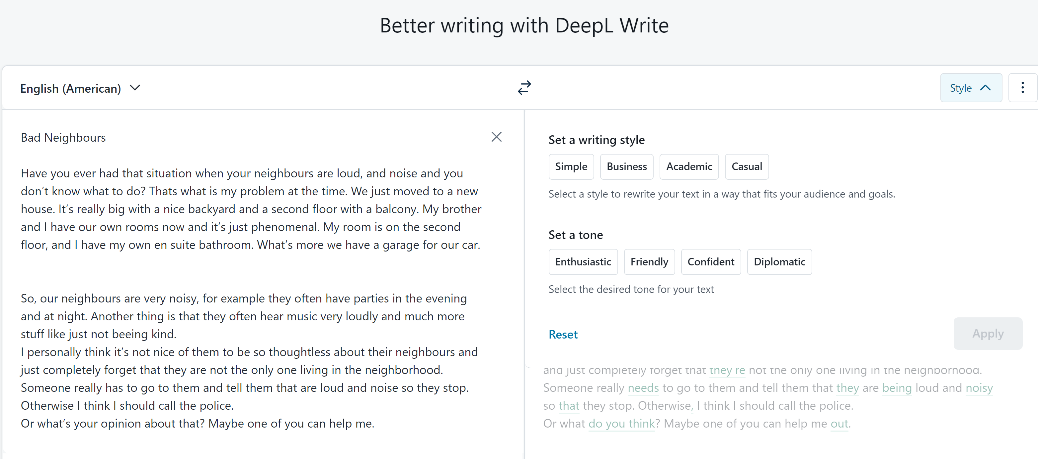



Slide 5
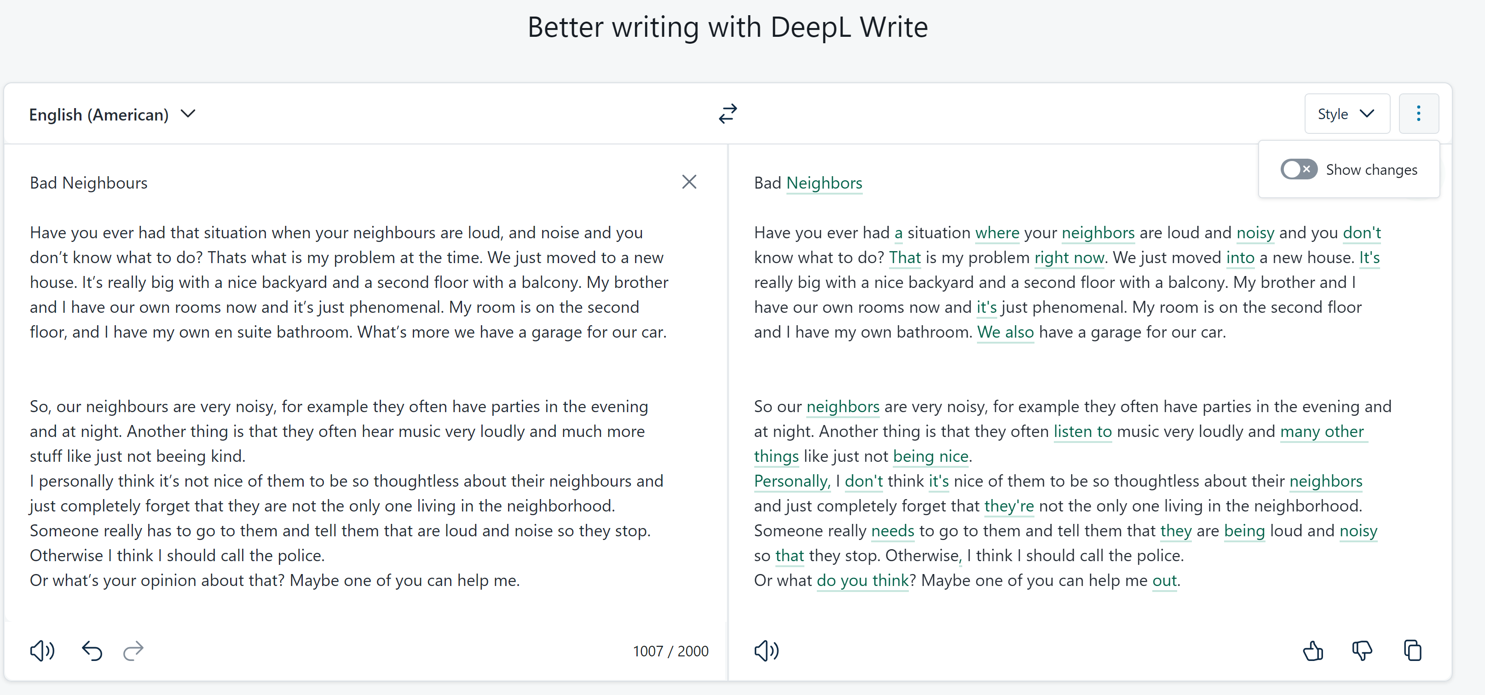

DeepL Write: corrections only

Slide 6
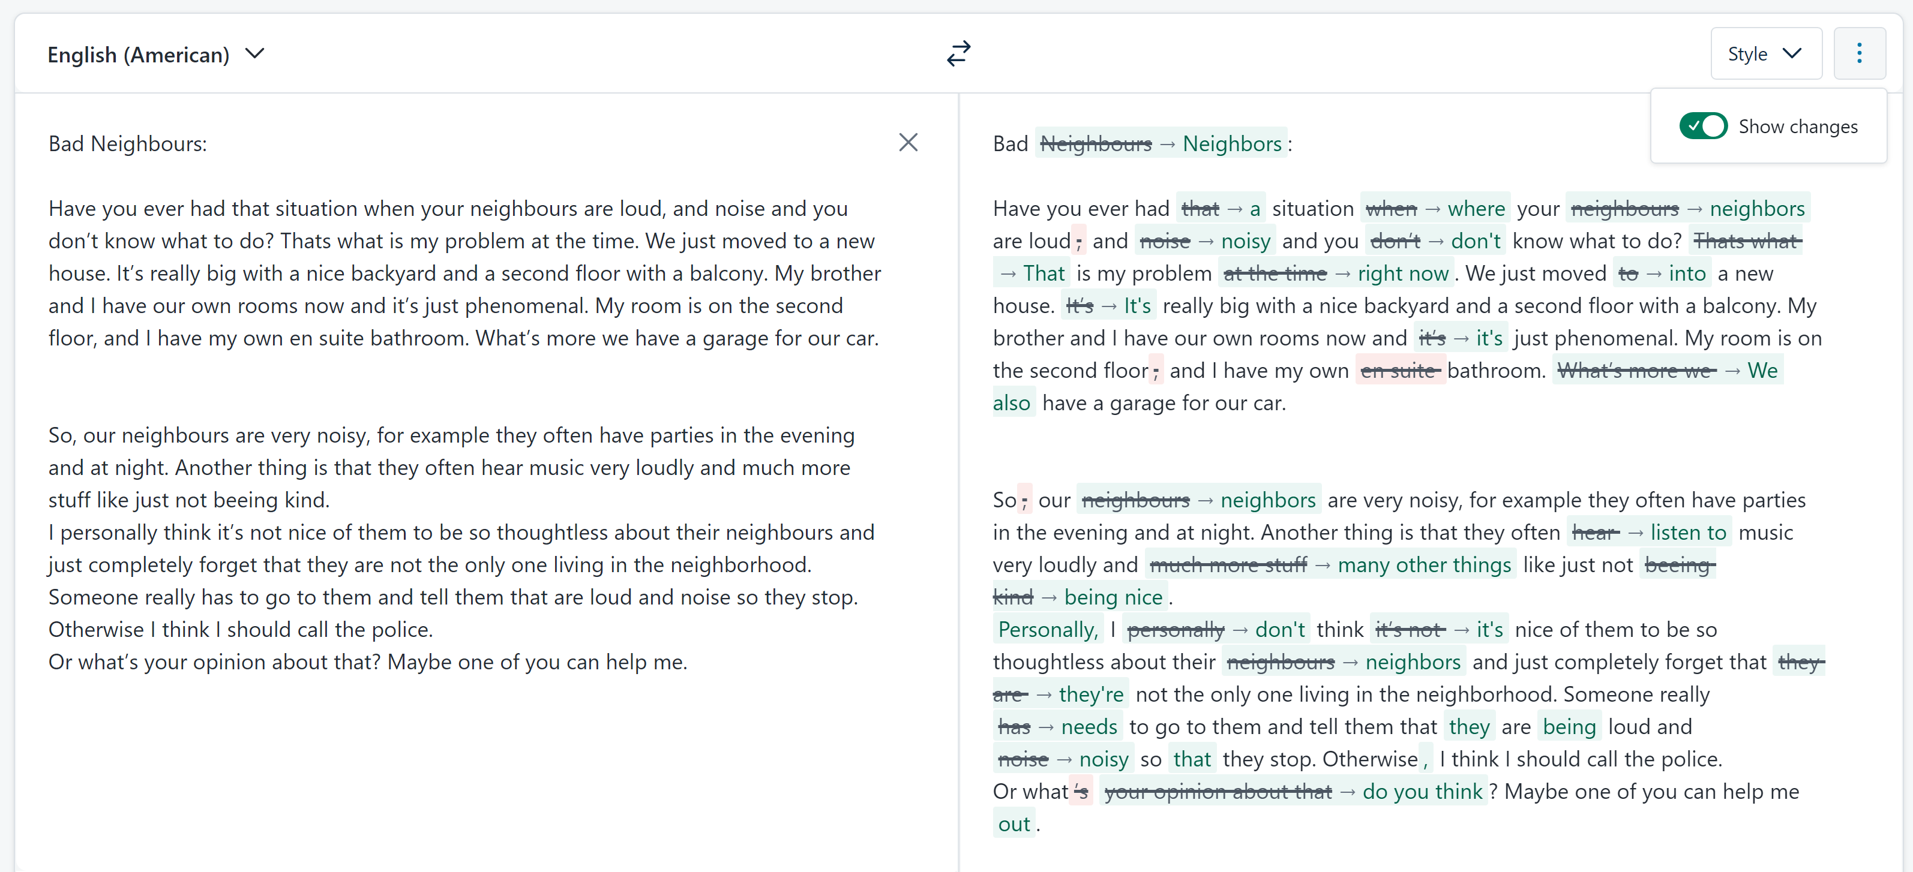
DeepL Write: corrections only – show changes

Slide 7
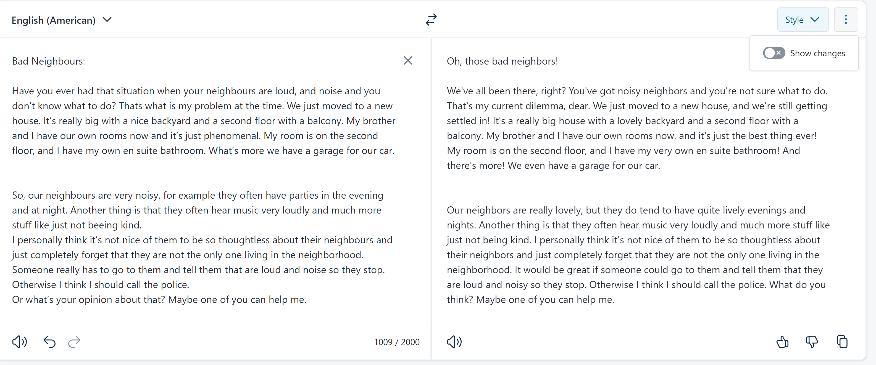
DeepL write: Friendly tone

Slide 8
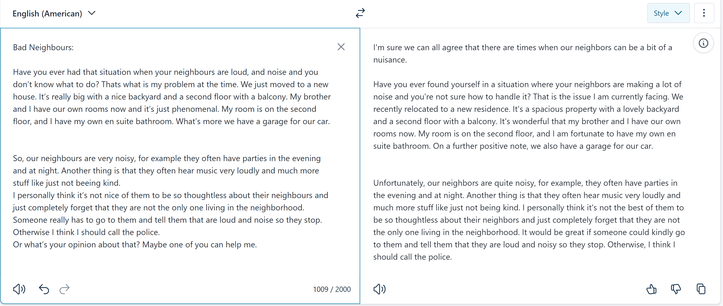
DeepL Write – diplomatic tone

Slide 9
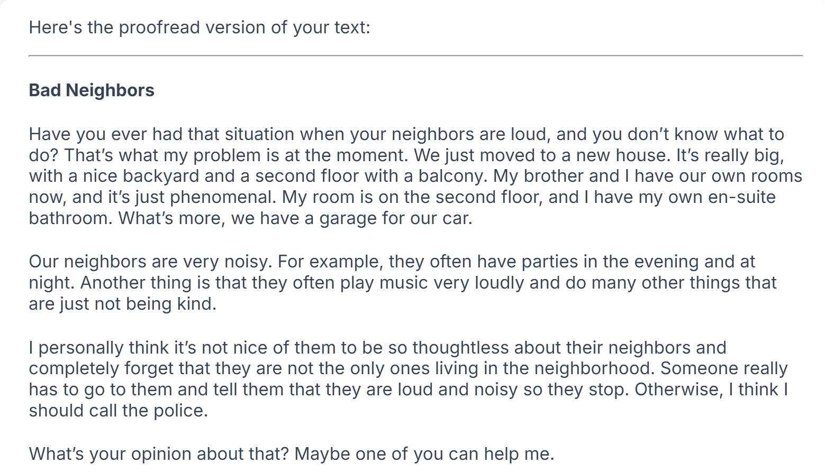


Slide 10
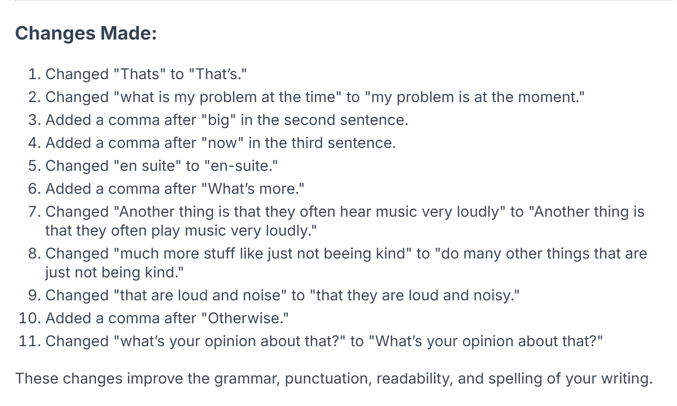
Unfortunately, the changes are not marked in the text and therefore not easy to spot for the learners.
They need to consult the list of changes, but do not see them in context.

Slide 11
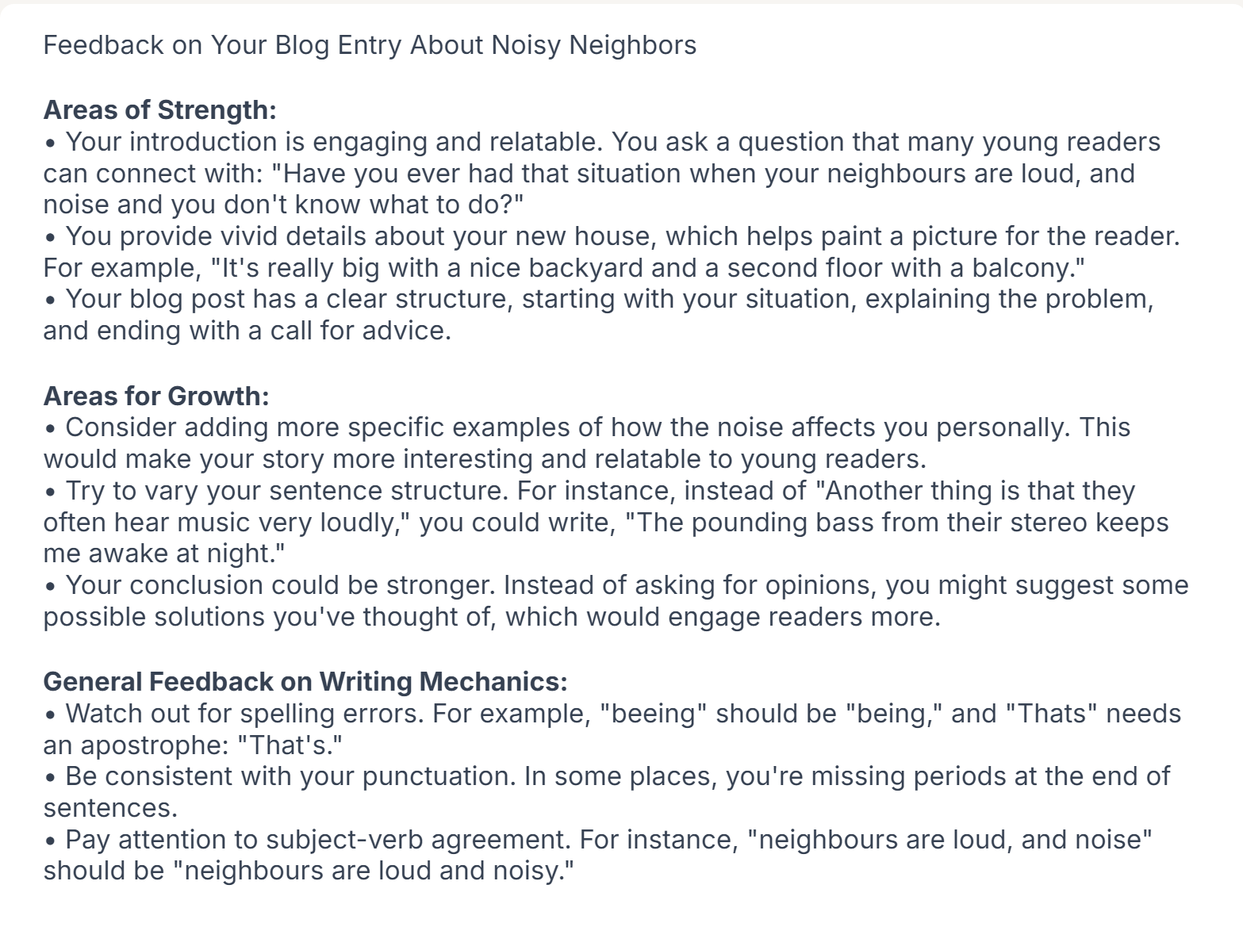
Helpful feedback for revising and editing.

