Slide 1
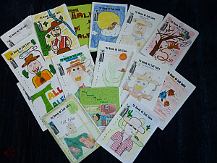
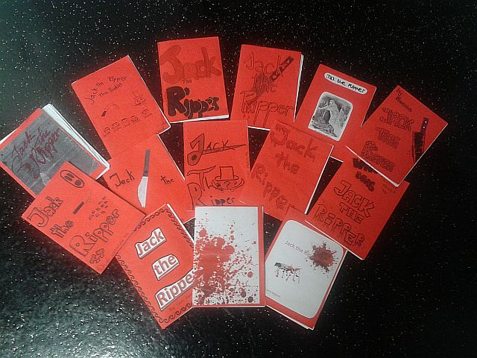
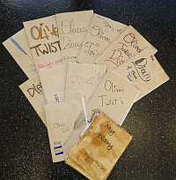
Creative Booklets The Pedagogy of the Blank Sheet
Dr. Elisabeth Pölzleitner
GIBS: Graz International Bilingual School
and
Institut für Anglistik, Uni Graz

Slide 2
Overview
Framework/ Setting
Task-based Learning and Learner Autonomy
H. and H. Zehnpfennig‘s pedagogy of the blank sheet
Practical Examples
Reading projects for different age-groups
Oral formats of the same idea
Video-presentations
Bookmaking
Online books (using bookr and Jing)
Exploring learner products
Discussion and questions

Slide 3
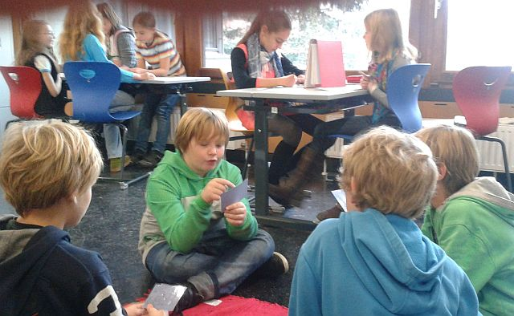
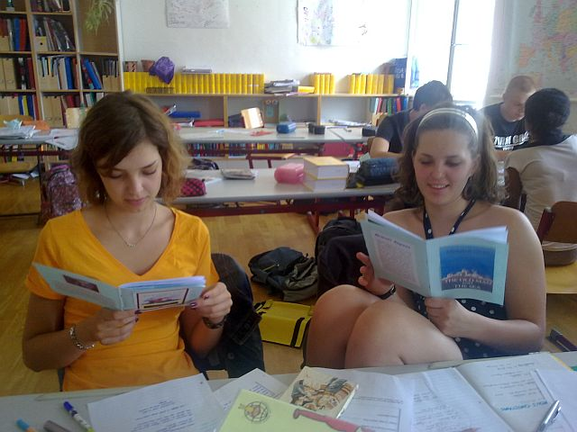
The Setting
Learners at secondary school (ages 10 – 18)
Groupsize: ~25 students in each class
English lessons only (no open learning periods)
Workshops about 90% of the time
No use of textbook
Mainly TBT (task based teaching) (Willis 2007)

Slide 4
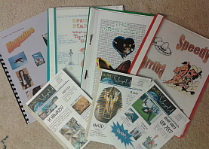
Underlying Approach: Task-based Teaching
„A piece of classroom work which involves learners in comprehending, manipulating, producing, or interacting in the target language while their attention is principally focused on meaning rather than form.“ (Nunan 1989)
Guiding questions: (Willis 2007)
Does the activity engage learners‘ interest?
Is there a primary focus on meaning?
Is there an outcome?
Is success judged in terms of outcome?
Is completion a priority?
Does the activity relate to real world activities?

Slide 5
Our Goal: Learner Autonomy
„The autonomous learner is one that constructs knowledge from direct experience, rather than one who responds to someone‘s instruction“
„Our job is to create learning opportunities, not to impose a method“ There‘s more than one way to learn a language.“
(Benson 2001)

Slide 6
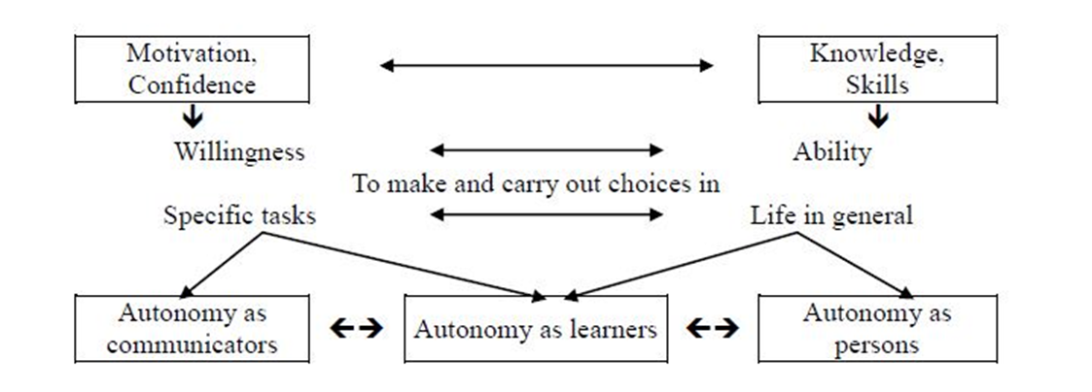
Our Goal: Learner Autonomy
„We can define an autonomous person as one who has an independent capacity to make and carry out the choices which govern his or her actions.
This capacity depends on 2 main components: ability and willingness.
Ability depends on possessing both knowledge about the alternatives from which choices have to be made and the necessary skills for carrying out whatever choices seem most appropriate.
Willingness depends on having both the motivation and the confidence to take responsibility for the choices required.“ Littlewood W. (1996:428)

Slide 7
Degrees of openness and autonomy
Topics
Given by teacher
Suggested by the class
Groups choose their own topics
Tasks
Activities given by teacher
e.g.: in workshops only the time and place are open, all tasks must be completed
General framework given:
e.g.: create a booklet of n pages
present the topic in a 5 minute radio-show
present the topic in a 5 minute video

Slide 8
The pedagogy of the blank sheet Hannelore and Helmut Zehnpfennig (2009)
No use of textbooks
Reduction of materials and input
Basic reference materials or online search
The blank sheet: no tasks, no questions, no instructions
Forces learners to actively search for meaning, fosters learner creativity, problem solving and interaction, encourages the construction of meanings and concepts

Slide 9
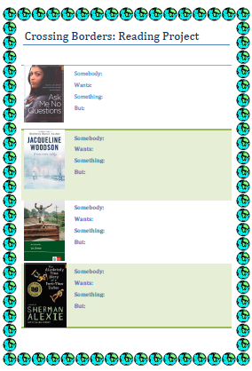
Reading projects for different age groups
Typical steps
Bookchoosing
Reading stage
Discussion and project-work in groups
Presentation phase:
Open tasks: written and/or oral production

Slide 10
Example: Reading project year 3

Slide 11
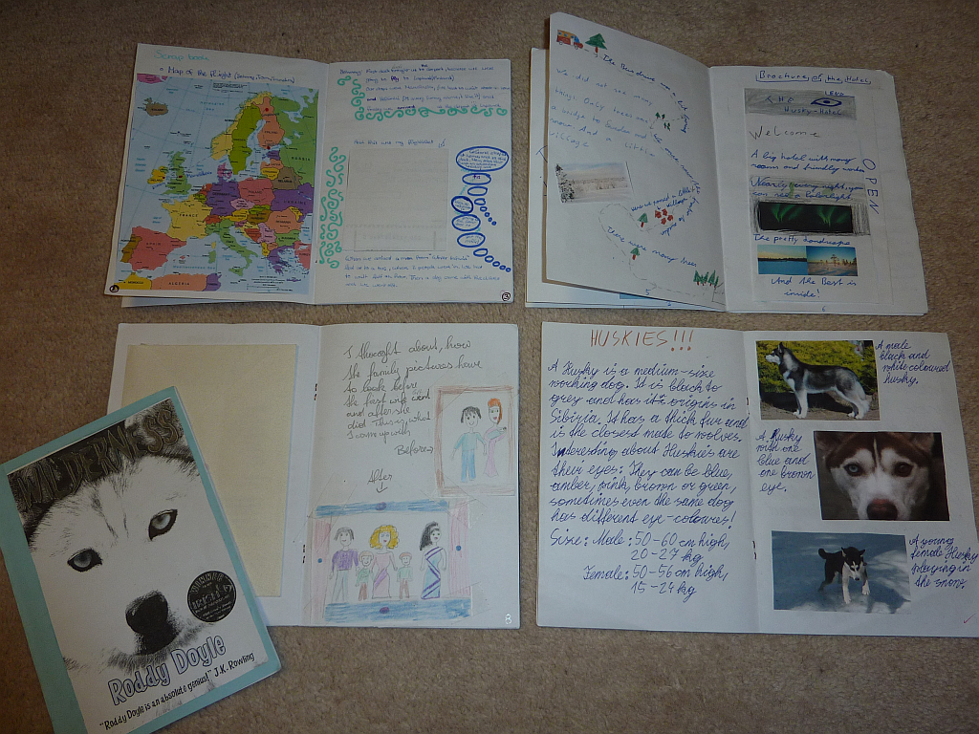

Slide 12
Table of contents

Slide 13
Character portraits

Slide 14
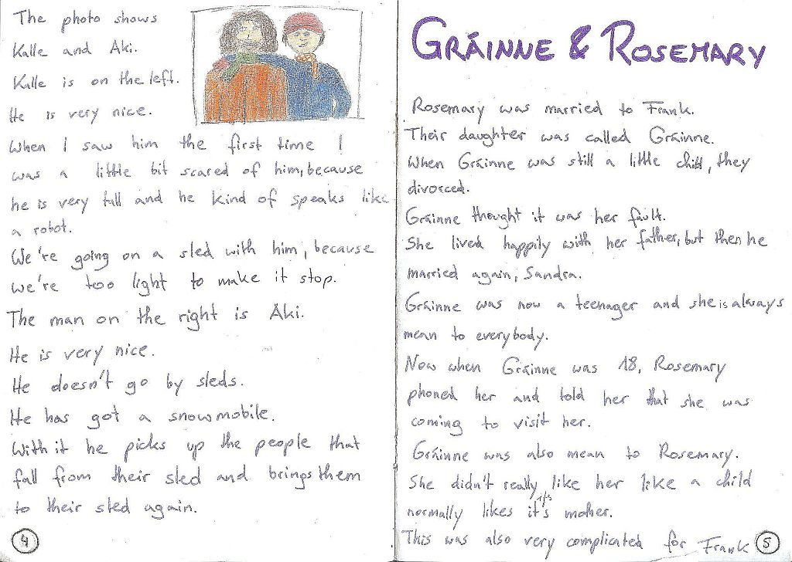
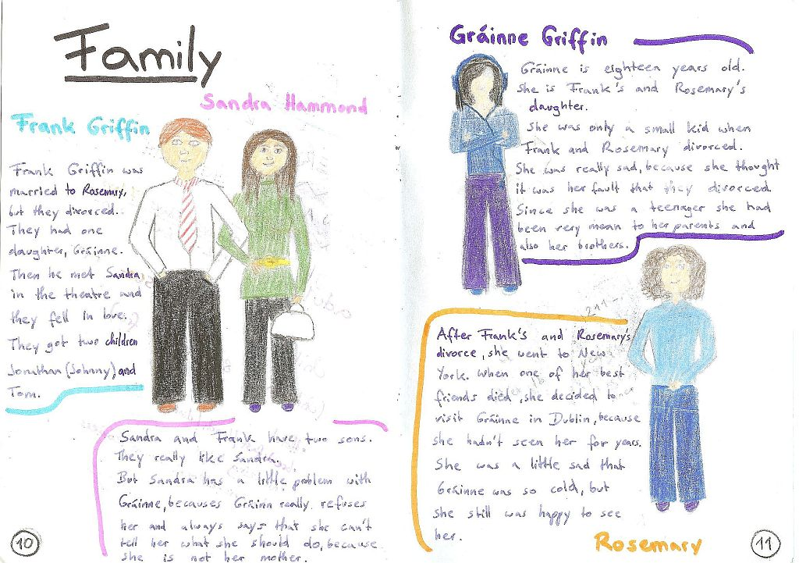

Slide 15
Newspaper articles and ads

Slide 16
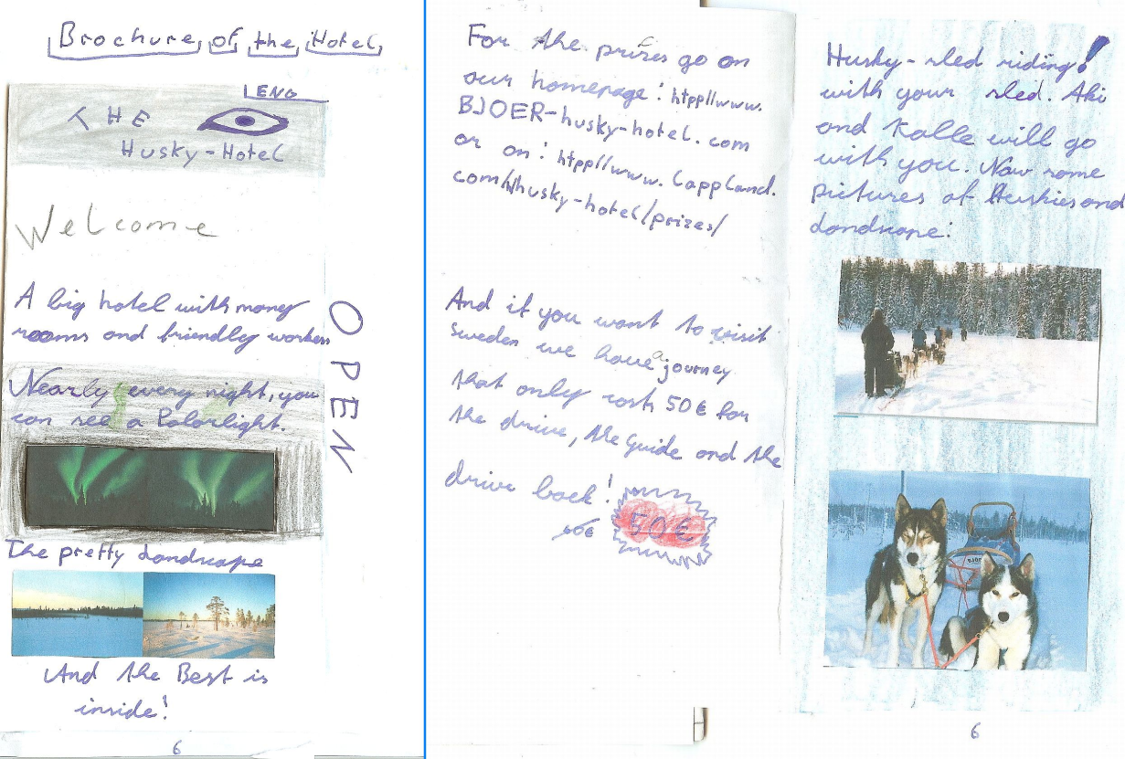
Ads and brochures

Slide 17
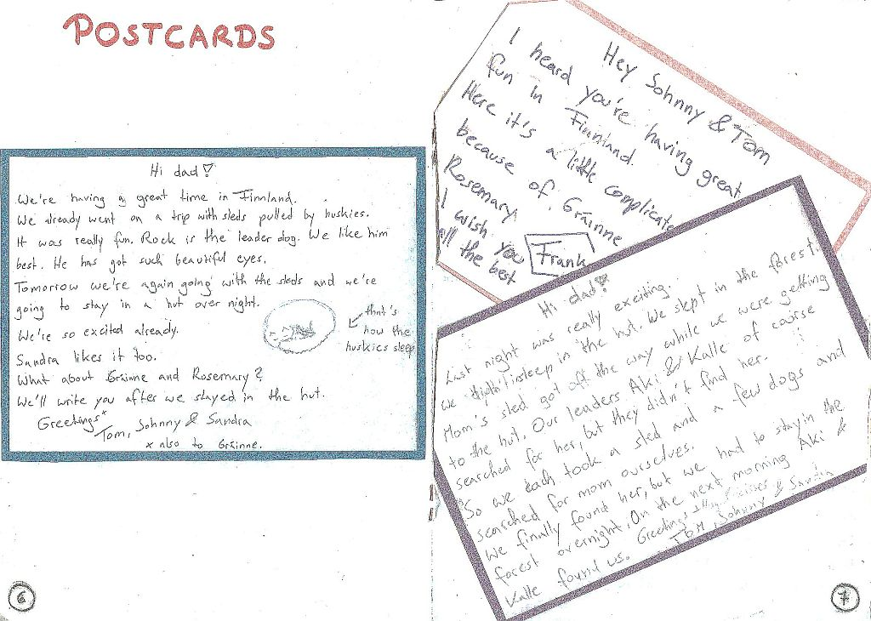
Letters and postcards

Slide 18
Background information and research

Slide 19
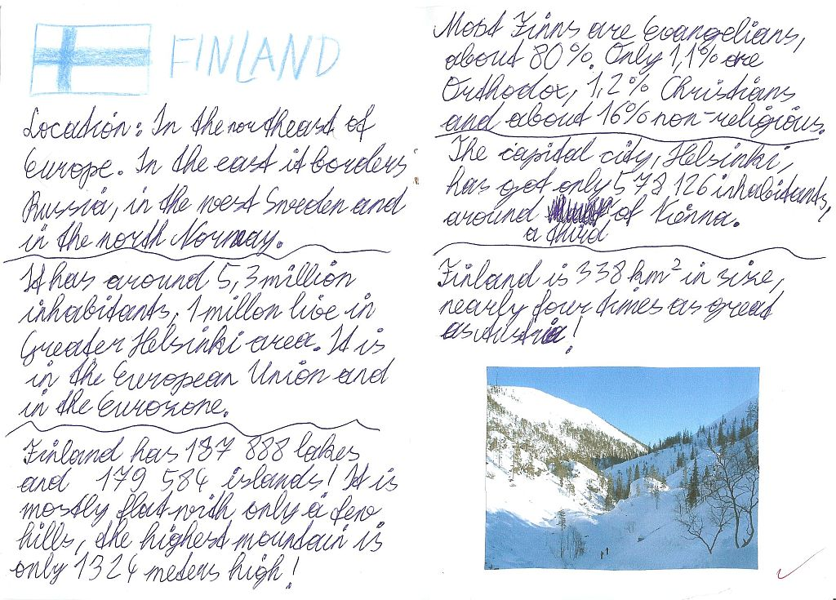

Slide 20
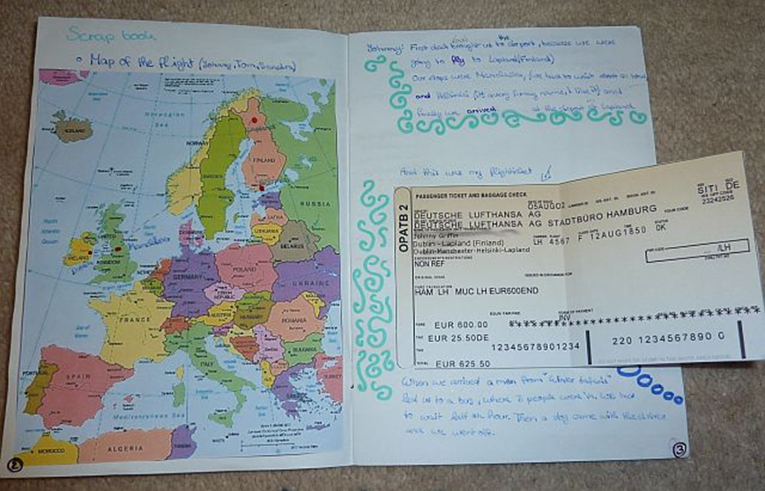
Maps and tavel information

Slide 21
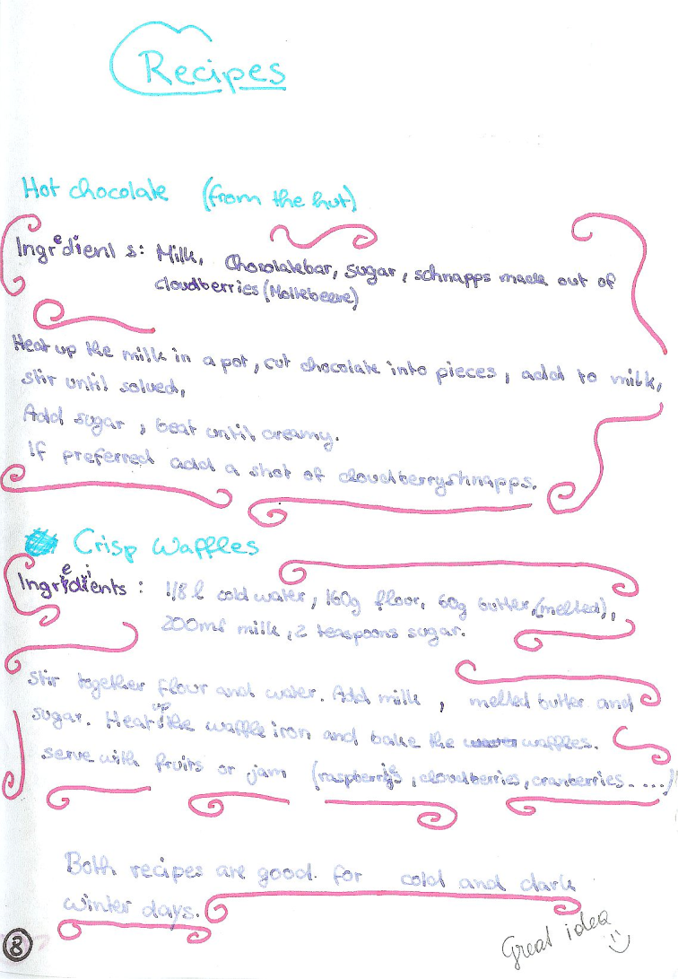
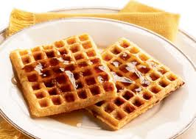
Food and Recipes

Slide 22
Example year 4: Teens in Trouble
Choice of books
Holes
Stone Cold
Gangsta Rap
Boot Camp

Slide 23
Upper-school Examples

Slide 24
Cover page and letter to the author

Slide 25
Author info and Plot diagram

Slide 26
Character portraits

Slide 27
Quotes and Setting

Slide 28
Newspaper article

Slide 29
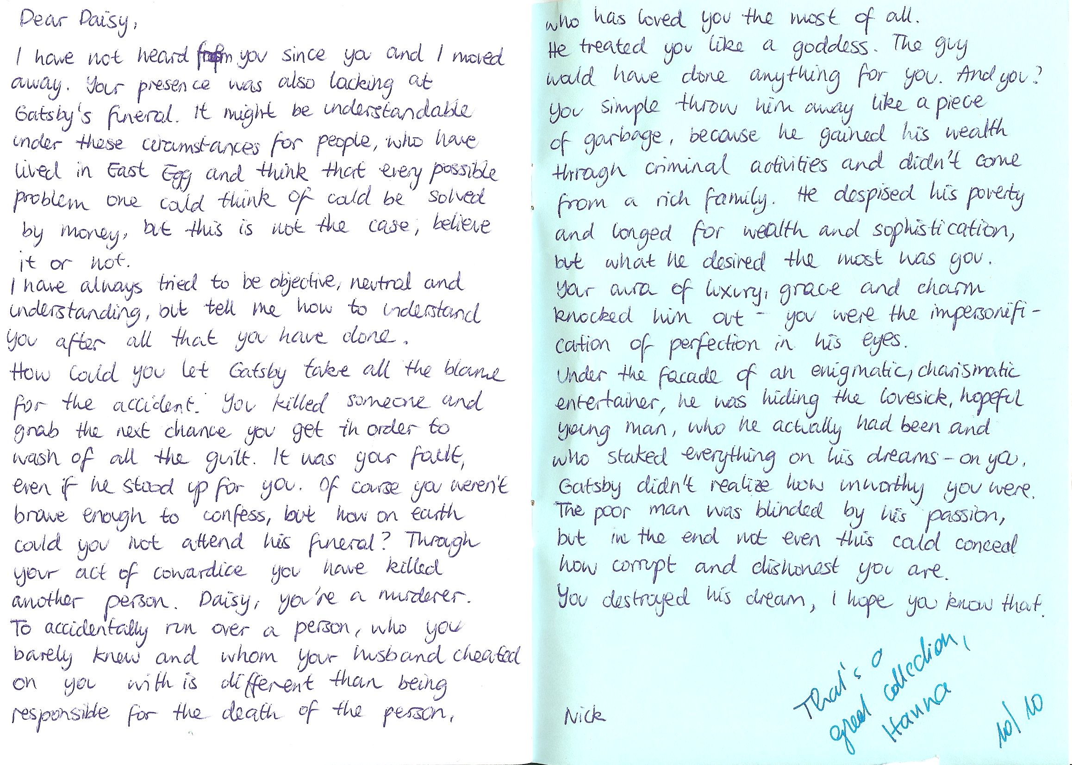
Diary entries

Slide 30
Letter to the author and drawings

Slide 31
If I had been in this place...

Slide 32
Plot diagram (The Pearl)

Slide 33
Drawings

Slide 34
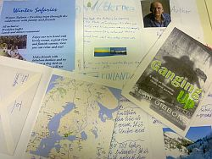
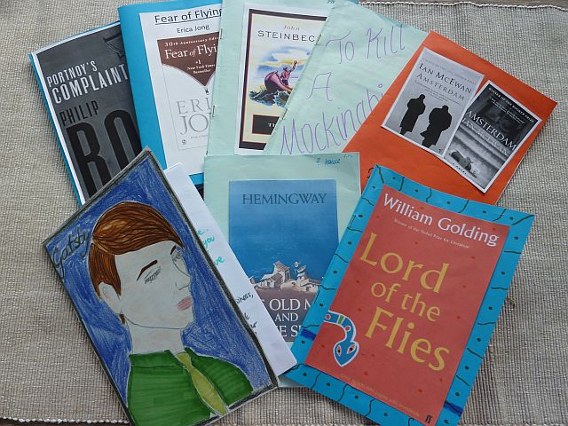
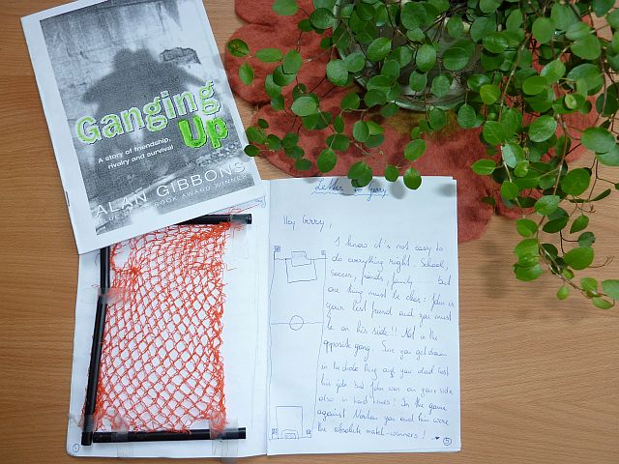
Booklet Browsing
You now have 10 minutes to look at different examples of booklets in detail.
What skills and strategies have the learners used/ practiced in these projects? Make a list.

Slide 35
In these projects the learners...
make lots of choices, take decisions
do activities that seem relevant to them
are actively involved and use the language actively (receptively and productively)
cooperate and communicate with others
manage time and resources
persue personal goals and group goals
are proud of their results
build growth-oriented mindsets

Slide 36
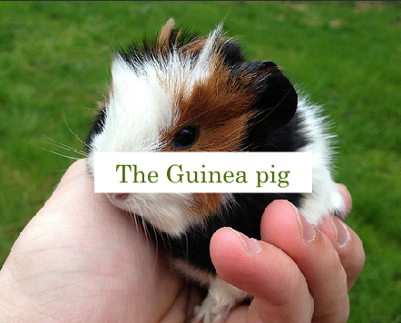
Online Books: Same idea – other media
Beginners: year 1
A book about Guinea pigs
Superman

Slide 37
Oral formats of the same idea
Instructions for the learners:
Show your understanding of the book using Mybrainshark.com. Do not use any writing.
Examples:
The Curious Incident of the Dog in the Night-time
Example 1: Walking in Christopher‘s shoes
Example 2: A normal schoolday
Example 3: Walking in someone else‘s shoes
The Man Who Loved Clowns
Freak the Mighty
Bluefish

Slide 38
Levels of Learner Autonomy: Where are we?
L | Learner Action | Content | Process
1 | Awareness | Learners are made aware of the pedagogical goals and content of the materials they are using | Learners identify strategy implications of pedagogical tasks and identify their own preferred learning styles/ strategies
2 | Involvement | Learners are involved in selecting their own goals from a range of alternatives on offer. | Learners make choices among a range of options.
3 | Intervention | Learners are involved in modifying and adapting the goals and contents of the learning programme. | Learners modify/adapt tasks.
4 | Creation | Learners create their own goals and objectives. | Learners create their own tasks.
5 | Transcend- ence | Learners go beyond the classroom and make links between teh content of classroom learning and the world beyond. | Learners become teachers and researchers. Nunan (1997: 195)

Slide 39
The End
Thank you for your attention.
For more ideas and examples visit
http://epep.at

Slide 40
References
Benson, P. (2001). Teaching and Researching Autonomy in Language Learning, Harlow: Pearson Education
Littlewood, W. (1996). "Autonomy”: an anatomy and a framework. System, 24/4, 427-435. Quoted from: http://www.finchpark.com/afe/l.html, 19.05.2012
Nunan, D. (1997). Designing and adapting materials to encourage learner autonomy. In P. Benson, & P. Voller. Autonomy and Independence in Language Learning. Harlow: Longman, 192 - 203.
Willis, D. and Willis J. 2007. Doing Task-based Teaching, Oxford: Oxford Handbooks for Language Teachers
Zehnpfenning, H. und Zehnpfenning H. 2008. online: http://www.zeugner.at/files/nachlese/010909/Go_OffUnt_Didaktik_des_weissen_Blattes.pdf

Slide 41
The End
Thank you for your attention.
For more ideas and examples visit
http://epep.at

