Slide 1
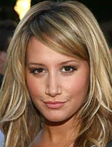
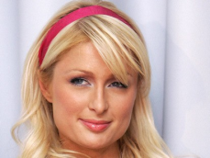
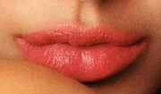
Celebrity Body Parts Match (girls)
Pattern: This is ........................‘s (celebrity) ................(body part). Or:
This is ........................ (body part) of ................... (celebrity).
Ashley Tisdale‘s
nose
Paris Hilton‘s
eyes
Angelina Jolie‘s
lips
front and backside of the card

Slide 2
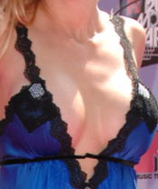
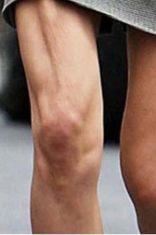
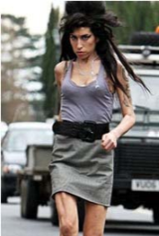
Heidi Klum‘s
belly
chest
Heidi Montag‘s
Amy Winehouse‘s
leg
feet
Halle Berry‘s

Slide 3
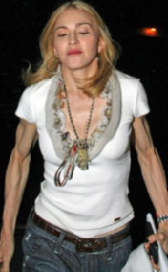
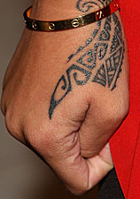
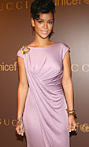
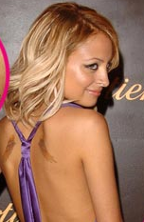
arm
Madonna‘s
hand
Rihanna‘s
Nicole Richie‘s
back
Jennifer Lopez‘s
neck

Slide 4
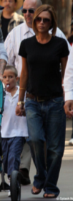
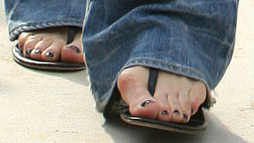
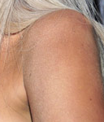
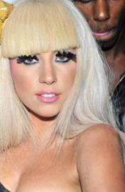
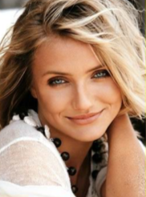
Miley Cyrus‘s
finger
Victoria Beckham‘s
toes
Lady Gaga‘s
shoulder
?
Cameron Diaz‘s
face

Slide 5
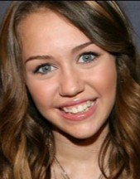
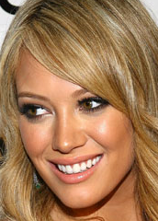
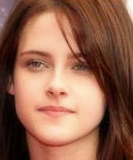
Miley Cyrus‘s
nose
Hillary Duff‘s
eyes
Kristen Steward‘s
mouth

Slide 6
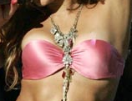
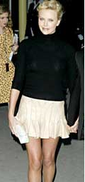
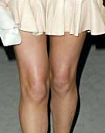
Keira Knightley‘s
belly
chest
Shakira‘s
Charlize Theron‘s
legs
feet
Katie Perry‘s

Slide 7
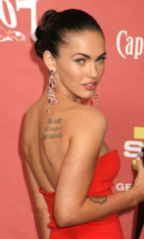
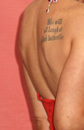
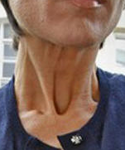
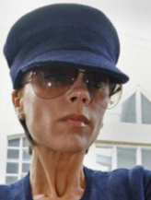
Britney Spears‘s
arm
hand
Jennifer Aniston‘s
Megan Fox‘s
back
Victoria Beckham‘s
neck

Slide 8
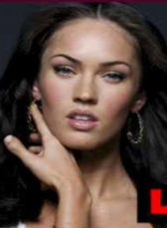
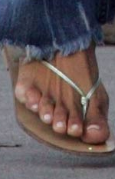
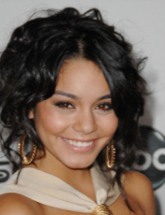
Megan Fox‘s
finger
Halle Berry‘s
toes
Halle Berry‘s
shoulder
Vanessa Hudgens‘s
?
face

