Slide 1
bright red triangles on light red background
Memory Match:
Colors and Shapes
grey triangles on bright pink background
Red, yellow and green vertical stripes
black circles on grey background
red, yellow and green horizontal stripes
blue circles on bright pink background

Slide 2
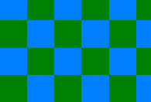
yellow stars on light blue background
bright pink dots on brown background
white stars on brown background
orange dots on purple background
blue and green rectangles
(Checkerboard)
yellow and purple wavy stripes
black and white rectangles (Checkerboard)
green and orange wavy stripes

Slide 3
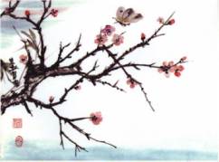
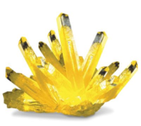
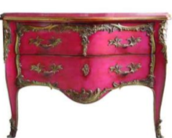
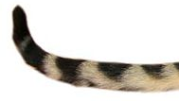
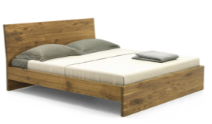
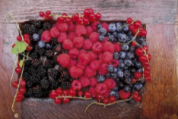
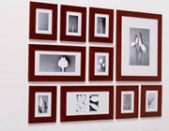
Vocabulary Cards: Test-Yourself
Back and front of the card
twig
crystal
feather
a chest of drawers
a fury tail
a bed
berries
pictures on a wall

Slide 4
SAMPLE
POSTER
Self-made Celeb

